Slide 1

Welcome
Final Project Presentation by
Members:
Md. Ariful Islam - 16101029
Md. Abdur Rafiq - 16101020
Md. Ali Islam Khan - 16101011
Md. Abu Nayem - 16101030
Supervisor :
Molla Rashied Hussein Rupak
Asst. Professor, Dept. of CSE
University of Asia Pacific

Slide 2

Contents
Introduction
About Project
Language and Platform
Showcase of project features ( Public Access and Admin Panel Part)
Specialty
Future Work with this project
Conclusion

Slide 3

Introduction
We make a project for a Travel Agency Company. Name of the travel agency is “First Step Travel Agency”. We try to make all mandatory features for this travel agency website, Like showcasing of activity, offers,past trips, package details, booking , contact information etc.
Now this is a era of Technology. Every company launch their website, mobile application for marketing and increase their service and profit. According to these terms we try to show and maintain all present trends of FIRST STEP TRAVEL AGENCY.

Slide 4

About Project
In our project there are mainly 5 sections of features :
Home ( Represent Packages, Past Trips, Upcoming trips, offers)
About ( Represent about of FSTA)
Offers ( Represent offers)
Contact ( Represent contact info)
Login/ Signup ( Member can register themselves and using admin info admin can enter for maintain)

Slide 5
Language and Platform
We use HTML, CSS, JavaScript and for make responsive we use Bootstrap Framework for Front End
For Backend we use PHP and MySQL database language.

Slide 6
Showcase of Features

Slide 7
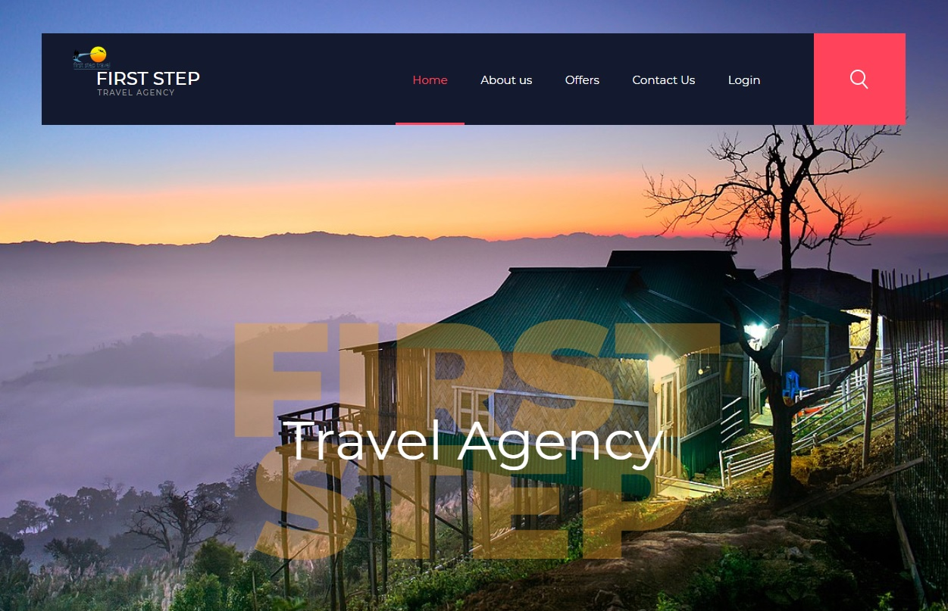
Home Page

Slide 8
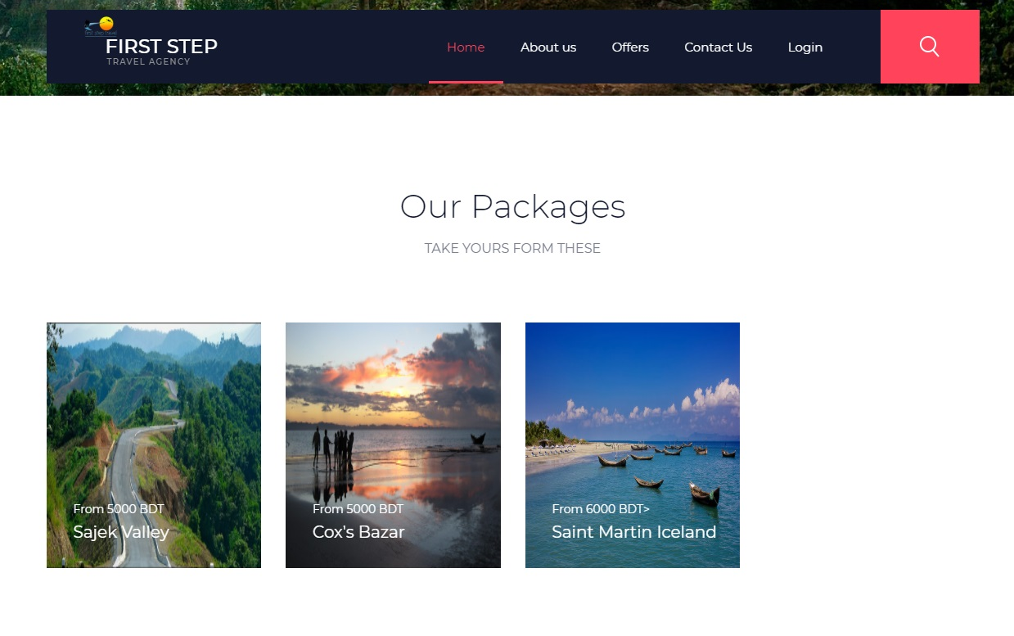

Slide 9
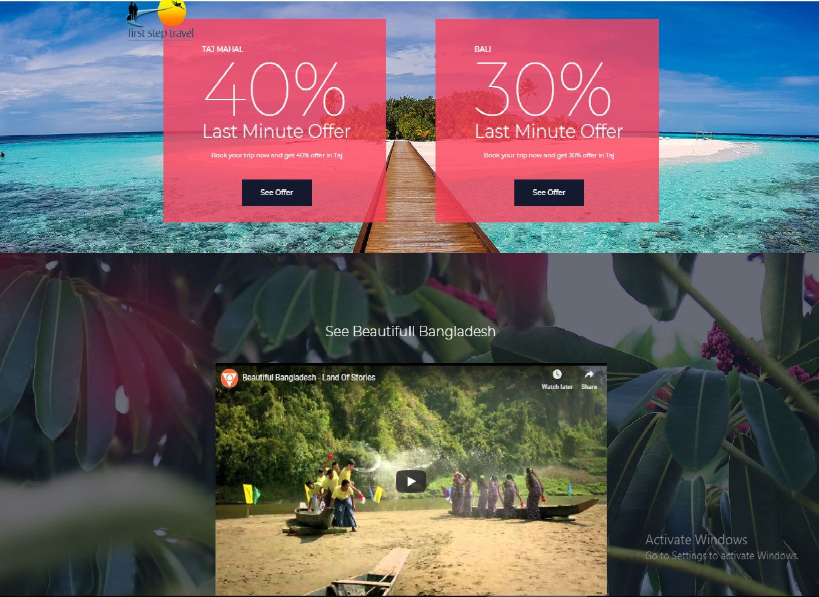

Slide 10
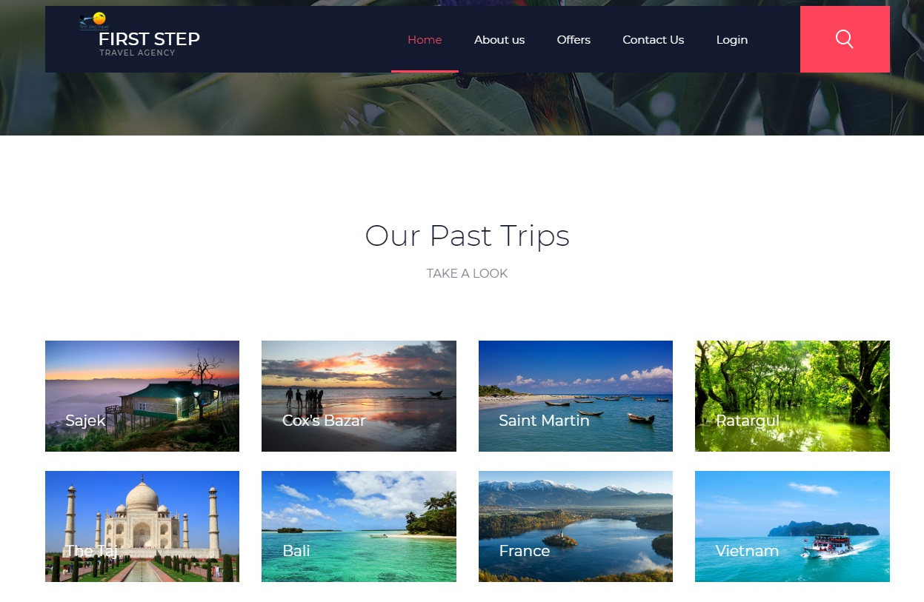

Slide 11
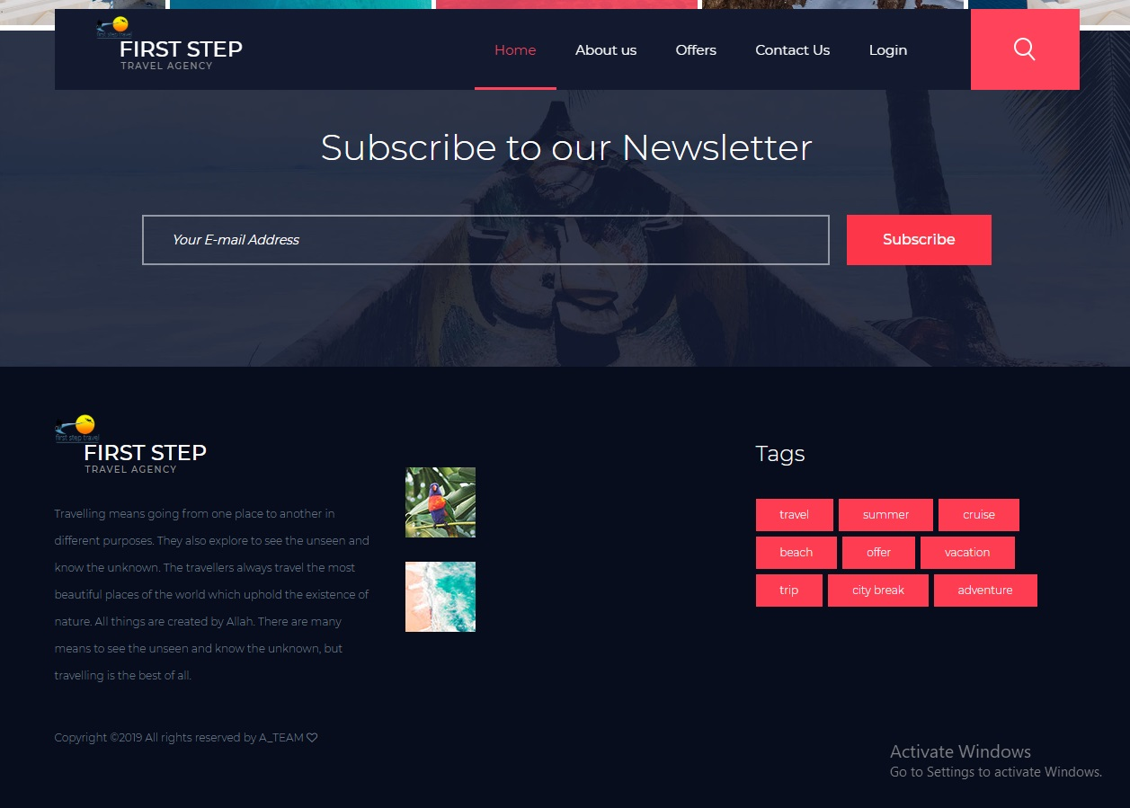

Slide 12
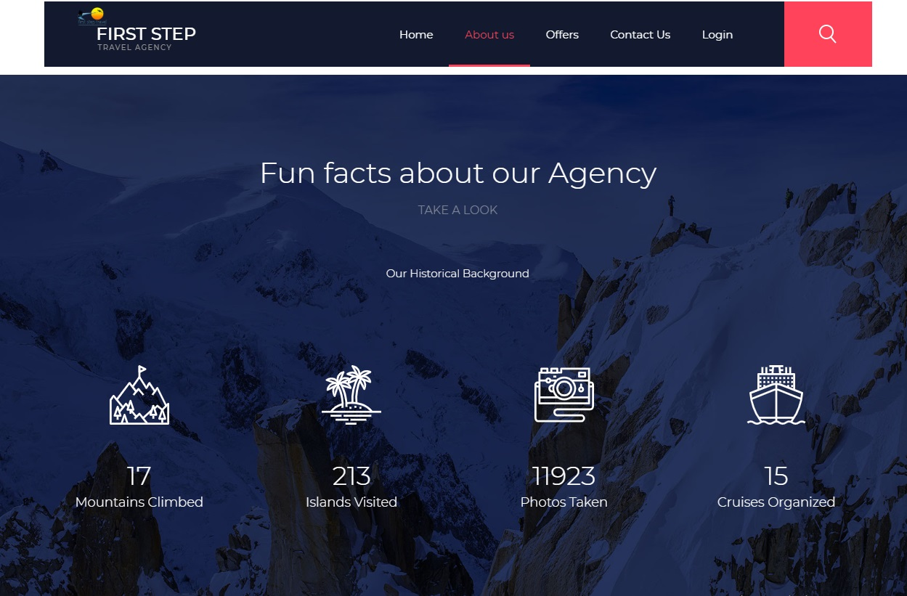
About

Slide 13
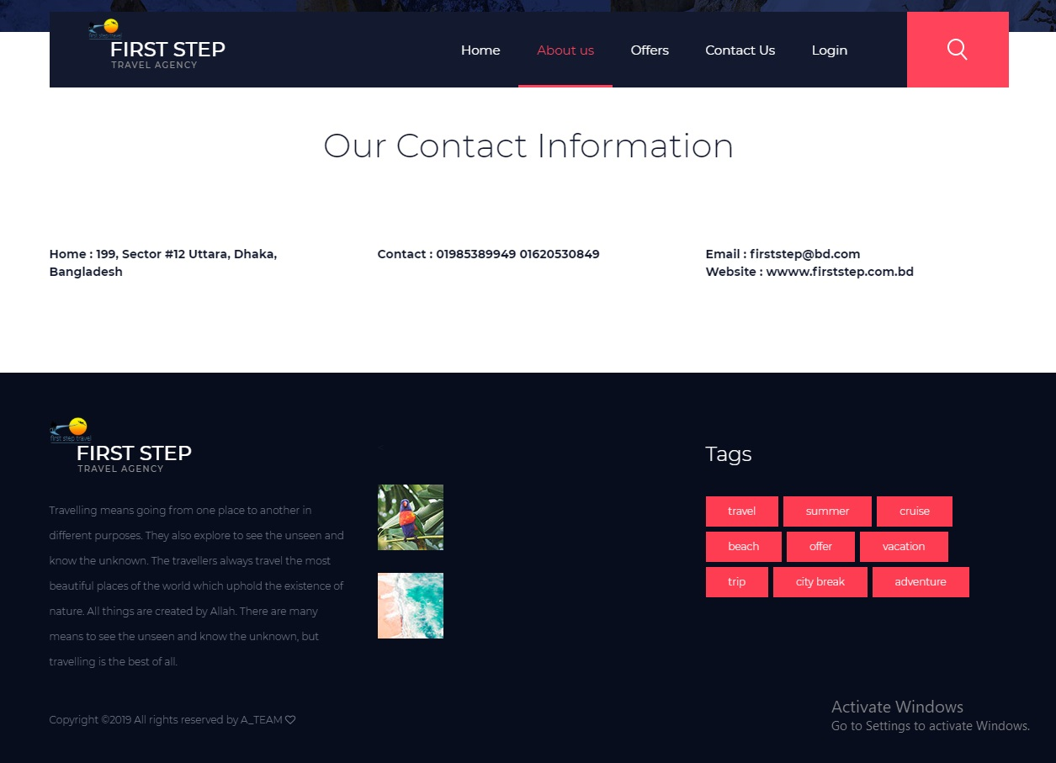

Slide 14
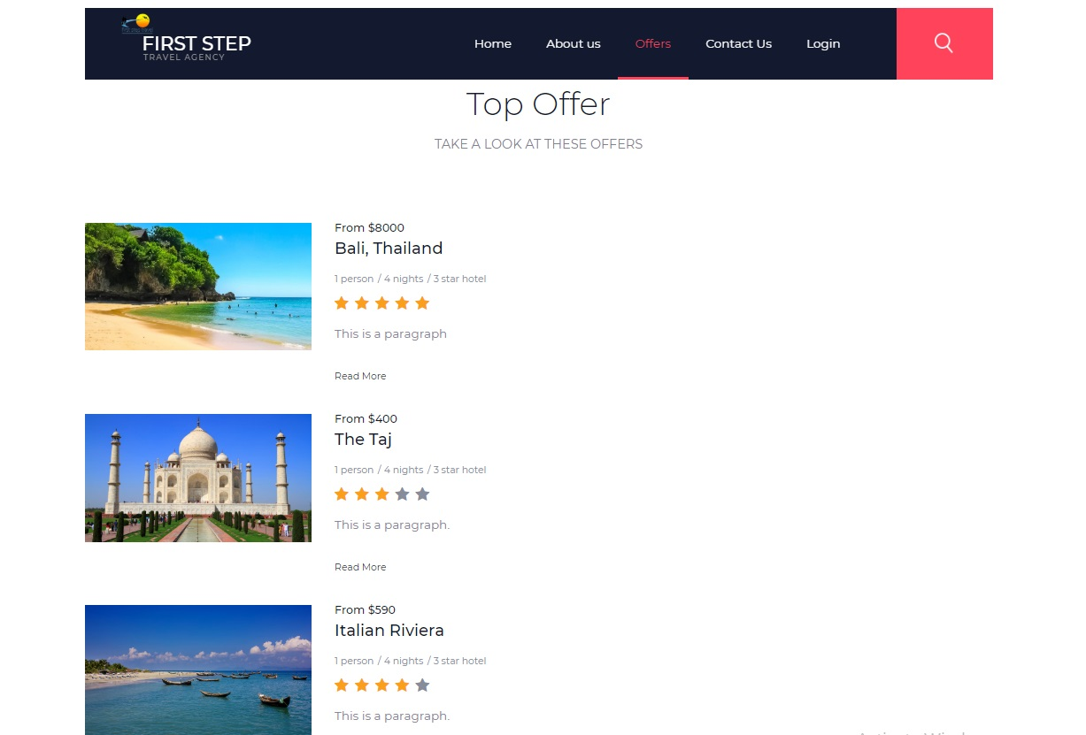
Offers

Slide 15
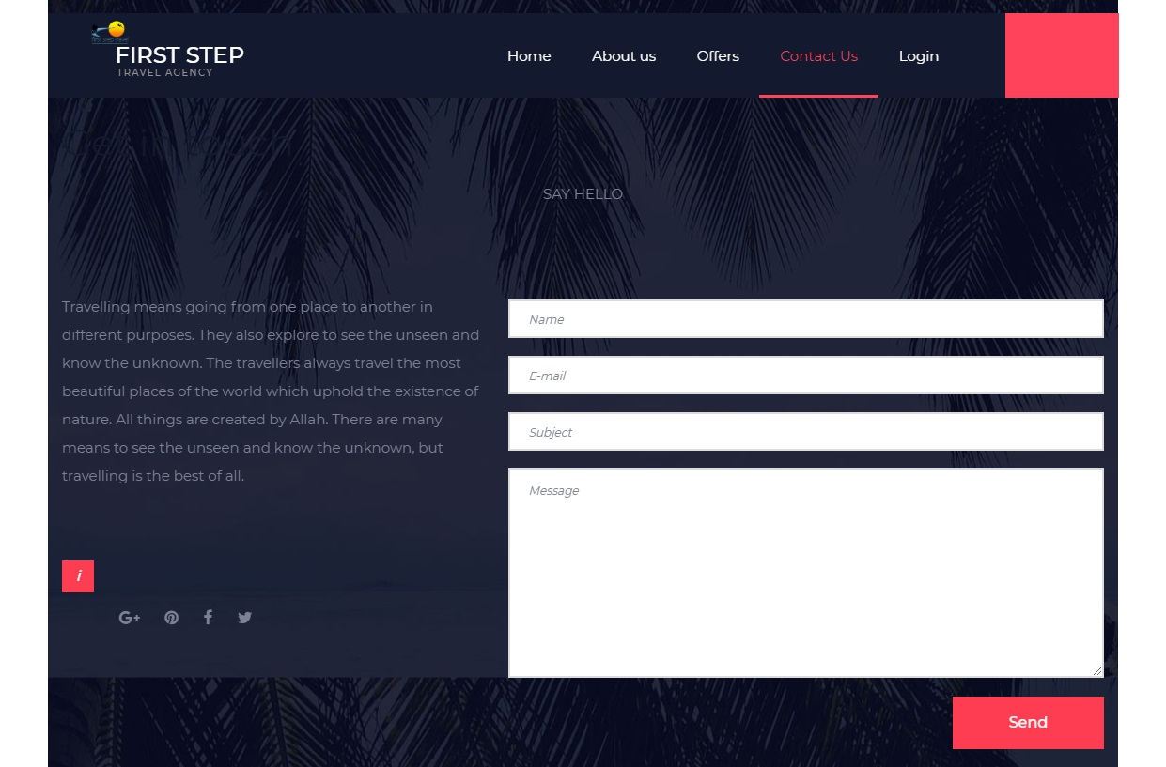
Contact Us

Slide 16
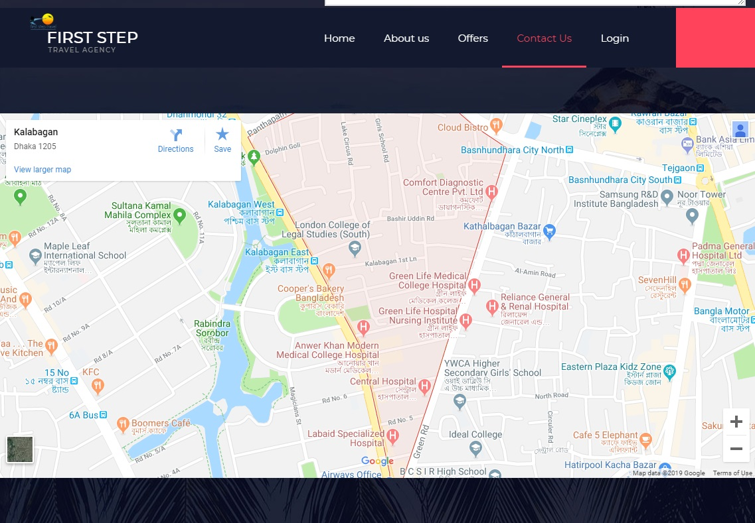

Slide 17
That is public access section of our project. Now… admin panel section and dashboard section that’s means management section.

Slide 18
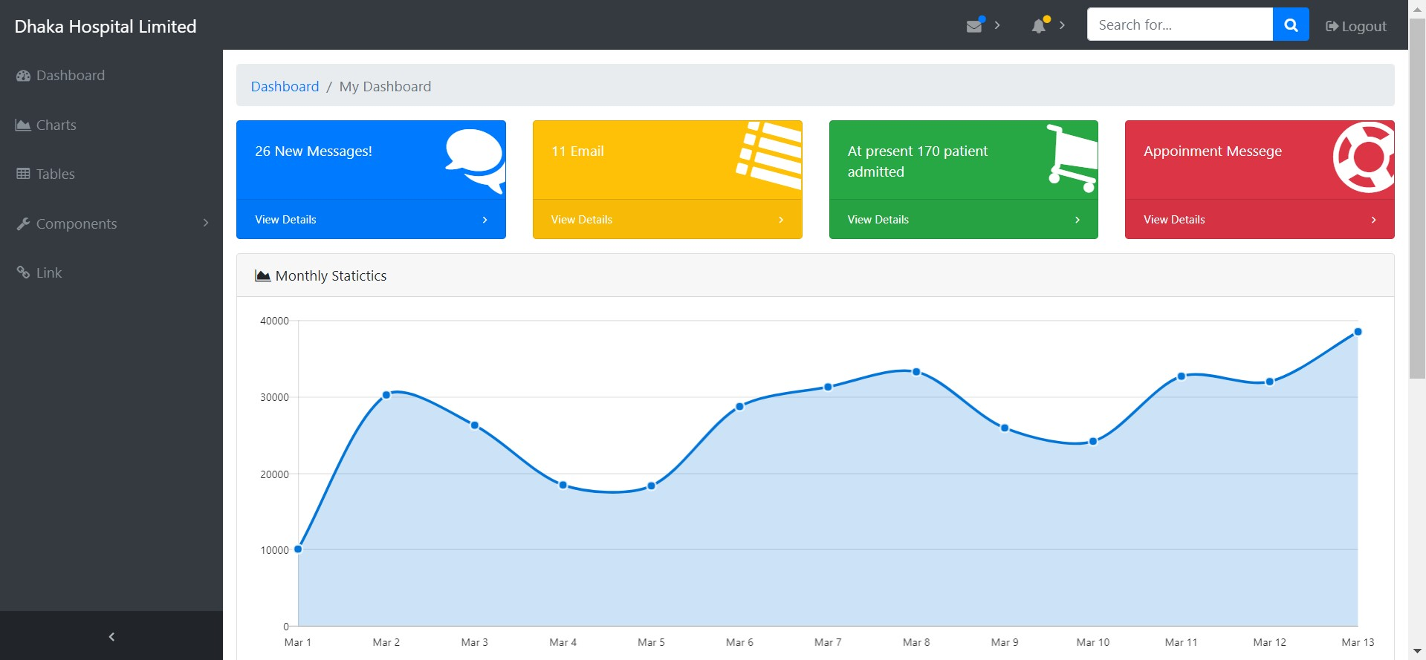
Admin Panel

Slide 19
Specialty
We use bootstrap framework , which is basic and a wonderful framework of html and css. This is a useful framework , user can use and handle it easily. It is a user-friendly framework.
We make all mandatory features by for attract customer attestation which is a important part of travel business.
For Admin panel, we also use bootstrap , in dashboard all the details are show and when admin log in with their user and password they can easily handle whole system without any complexion.
Admin can edit, update and delete any records easily.
For these reason we can say that our project is special.

Slide 20
Future Work
We will make a mobile app based on this website and also add more attractive
features for attract customer for First Step Travel Agency.

Slide 21
Conclusion
We try our best to represent all feature and term for a travel agency company. We
also try to make this user friendly with easy UX/UI by this Users and Controller can
use and handle easily. That’s all about our project.

Slide 22
Let’s See the Demo. . .

Slide 23
Thank You ☺

